Slide 1

FINANCELY
Discovery Programme
An educational app aimed at increasing financial literacy amongst young people.

Slide 2
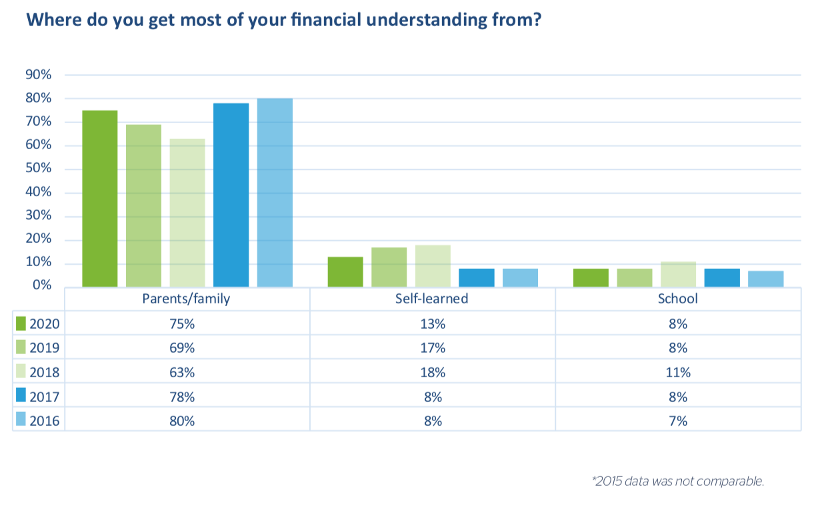
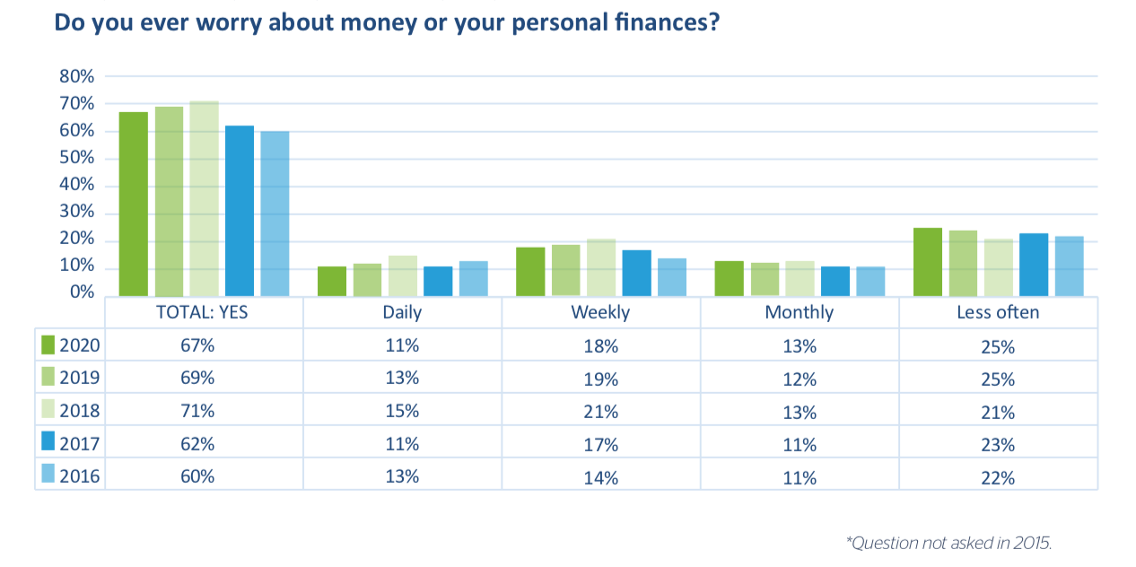
The London Institute of Banking & Finance (LIBF)
75% learn from Parent/Family
67% worry about money/personal finances
a representative sample of just over 2,000 secondary school children across the UK. Aged between 15–18, the young people came from a mix of schools including academies, local authority (state) schools, as well as private and independent schools

Slide 3
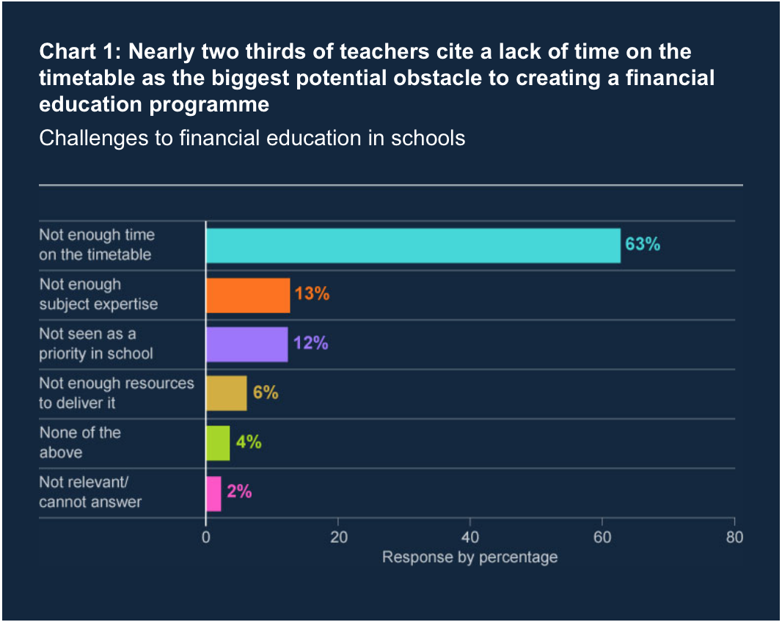
Solution to the gap in the market…
Financial education for children
Increasing usage of tech amongst children
Childhood 2020: new independent report
“Most children are now phone owners by the age of seven, with a big increase this year in the number of 5-10-year-olds who own their own mobile, according to the new 2020 CHILDWISE Monitor Report “
Childwise, a leading specialist in research with children and young people
Bank of England, ‘Financial education in a digital world’
Quarterly Bulletin 2022 Q1

Slide 4
Target Audience
7-17yrs old
Early years education
Access to tech
Parents/guardians

Slide 5

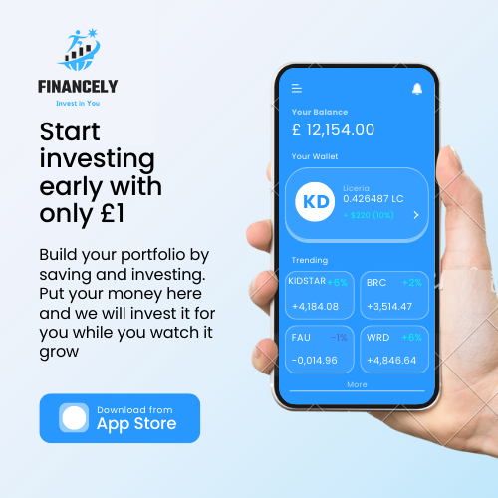
Branding & Logo

Slide 6





Competitors
GoHenry
Greenlight
Stockpile
NatWest Rooster Money
Revolut <18

Slide 7
Innovation
A virtual experience via gaming
Traditional banks
Pre-paid debt card, link with young current account
83% bank with a high street bank

Slide 8

Marketing & Commercial Strategy
Traditional Marketing: event marketing, focus groups, billboard, advertising
APP: app store optimization – keywords; early investment, kids banking [Natwest Rooster Money, GoHenry, Revolut <18], children’s savings account
Influencer marketing: where a large source of information on financial education derives from
Affiliate marketing: creating a buzz in the educational industry

Slide 9

Funding
Partner with a business (high street banks)
Crowdfunding
Venture capitals
Business grants (educational)

Slide 10
Thank you
Invest Financely

